Slide 1
Lecture 4: Informed Heuristic Search
ICS 270a Winter 2003

Slide 2
Summary
Heuristics and Optimal search strategies
  heuristics
  hill-climbing algorithms
  Best-First search
  A*: optimal search using heuristics
  Properties of A*
    admissibility,
    monotonicity,
    accuracy and dominance
    efficiency of A*
  Branch and Bound
  Iterative deepening A*
  Automatic generation of heuristics

Slide 3
Problem: finding a Minimum Cost Path
Previously we wanted an arbitrary path to a goal.
Now, we want the minimum cost path to a goal G
  Cost of a path = sum of individual transitions along path
Examples of path-cost:
  Navigation
    path-cost = distance to node in miles
      minimum => minimum time, least fuel
  VLSI Design
    path-cost = length of wires between chips
      minimum => least clock/signal delay
  8-Puzzle
    path-cost = number of pieces moved
      minimum => least time to solve the puzzle

Slide 4
Heuristic functions
8-puzzle
  W(n): number of misplaced tiles
  Manhatten distance
  Gaschnig’s
8-queen
  Number of future feasible slots
  Min number of feasible slots in a row
Travelling salesperson
  Minimum spanning tree
  Minimum assignment problem

Slide 5
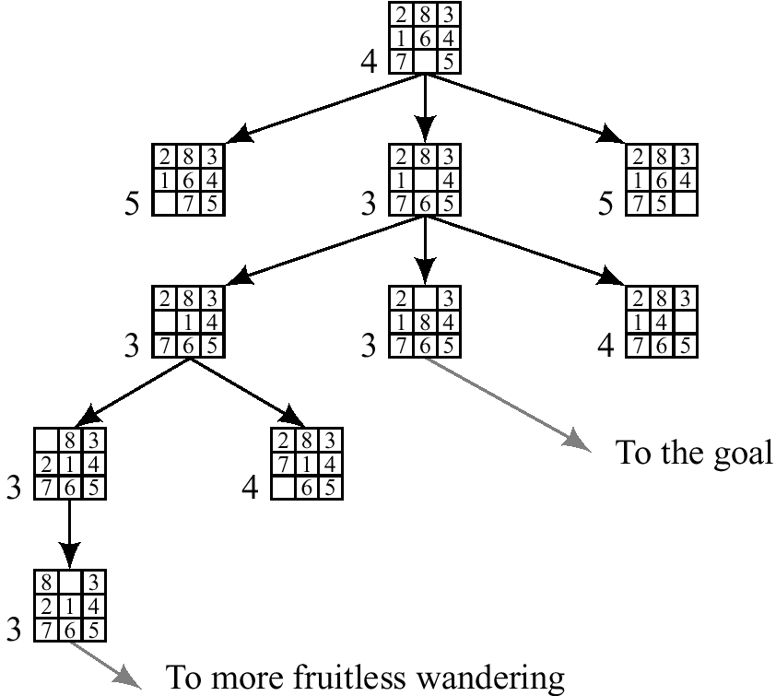
Best first (Greedy) search: f^(n) = number of misplaced tiles

Slide 6
Hill climbing, Greedy search
Example:
  8-queen, traveling salesperson, 8-puzzle, finding routes
Not systematic,
  based on local optimization, memoryless, used by humans
Uses an evaluation heuristic function
  that evaluates how far we are from the goal
Very greedy:
  Expand current node and select the best among its children only if it is better than its own value until found a solution or reached a plateau. Keep only current node.
Greedy:
  Expand current node and select the best among its children. Keep current path

Slide 7
Problems with Greedy Search
Not complete
Get stuck on local minimas and plateaus,
Irrevocable,
Infinite loops
Can we incorporate heuristics in systematic search?

Slide 8
Informed search - Heuristic search
How to use heuristic knowledge in systematic search?
Where ? (in node expansion? hill-climbing ?)
Best-first:
  select the best from all the nodes encountered so in OPEN.
  “good” use heuristics
Heuristic estimates value of a node
  promise of a node
  difficulty of solving the subproblem
  quality of solution represented by node
  the amount of information gained.
f(n)- heuristic evaluation function.
  depends on n, goal, search so far, domain

Slide 9
Best-First Algorithm BF (*)
1. Put the start node s on a list called OPEN of unexpanded nodes.
2. If OPEN is empty exit with failure; no solutions exists.
3. Remove the first OPEN node n at which f is minimum (break ties arbitrarily), and place it on a list called CLOSED to be used for expanded nodes.
4. Expand node n, generating all it’s successors with pointers back to n.
5. If any of n’s successors is a goal node, exit successfully with the solution obtained by tracing the path along the pointers from the goal back to s.
6. For every successor n’ on n:
a. Calculate f (n’).
b. if n’ was neither on OPEN nor on CLOSED, add it to OPEN. Attach a
pointer from n’ back to n. Assign the newly computed f(n’) to node n’.
c. if n’ already resided on OPEN or CLOSED, compare the newly
computed f(n’) with the value previously assigned to n’. If the old
value is lower, discard the newly generated node. If the new value is lower, substitute it for the old (n’ now points back to n instead of to its previous predecessor). If the matching node n’ resided on CLOSED, move it back to OPEN.
Go to step 2.
* With tests for duplicate nodes.

Slide 10
A*- a special Best-first search
Goal: find a minimum sum-cost path
Notation:
  c(n,n’) - cost of arc (n,n’)
  g^(n) = cost of current path from start to node n in the search tree.
  h^(n) = estimate of the cheapest cost of a path from n to a goal.
  Special evaluation function: f = g+h
f(n) estimates the cheapest cost solution path that goes through n.
  h(n) is the true cheapest cost from n to a goal.
  g(n) is the true shortest path from the start s, to n.
If the heuristic function, h^, always underestimate the true cost (h^(n) is smaller than h(n)), then A* is guaranteed to find an optimal solution.

Slide 11
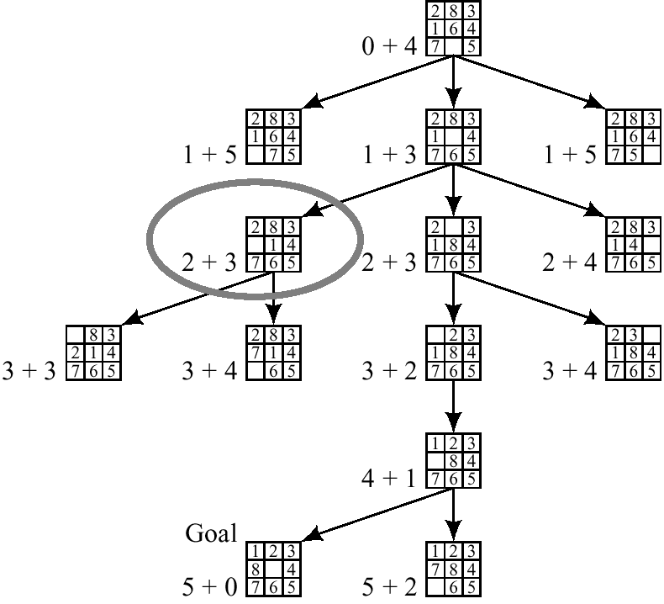
A* on 8-puzzle with h(n) = w(n)

Slide 12
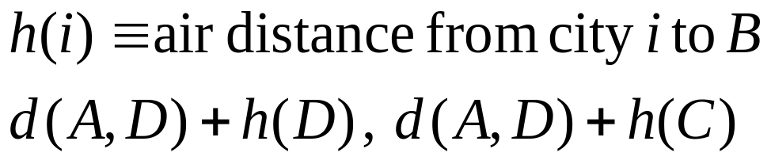
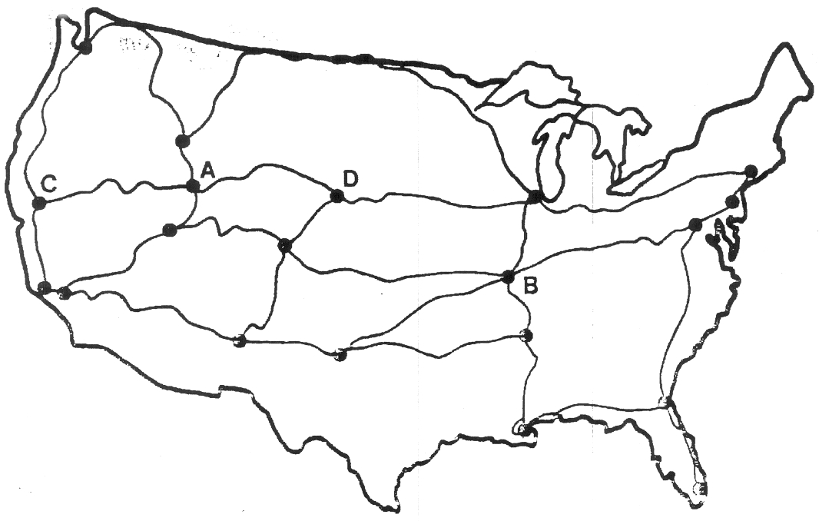
The Road-Map
Find shortest path between city A and B

Slide 13
1
4
A
B
C
2
S
2
5
G
5
3
2
4
D
E
F
A
10.4
B
C
6.7
4.0
11.0
G
S
8.9
3.0
6.9
D
E
F

Slide 14
Example of A* Algorithm in action
S
5 + 8.9 = 13.9
2 +10.4 = 12..4
A
D
3 + 6.7 = 9.7
B
D
4 + 8.9 = 12.9
7 + 4 = 11
8 + 6.9 = 14.9
C
E
E
6 + 6.9 = 12.9
Dead End
B
F
10 + 3.0 = 13
11 + 6.7 = 17.7
G
13 + 0 = 13

Slide 15
Algorithm A* (with any h on search Graph)
Input: a search graph problem with cost on the arcs
Output: the minimal cost path from start node to a goal node.
  1. Put the start node s on OPEN.
  2. If OPEN is empty, exit with failure
  3. Remove from OPEN and place on CLOSED a node n having minimum f.
  4. If n is a goal node exit successfully with a solution path obtained by tracing back the pointers from n to s.
  5. Otherwise, expand n generating its children and directing pointers from each child node to n.
    For every child node n’ do
      evaluate h(n’) and compute f(n’) = g(n’) +h(n’)= g(n)+c(n,n’)+h(n)
      If n’ is already on OPEN or CLOSED compare its new f with the old f and attach the lowest f to n’.
      put n’ with its f value in the right order in OPEN
  6. Go to step 2.

Slide 16
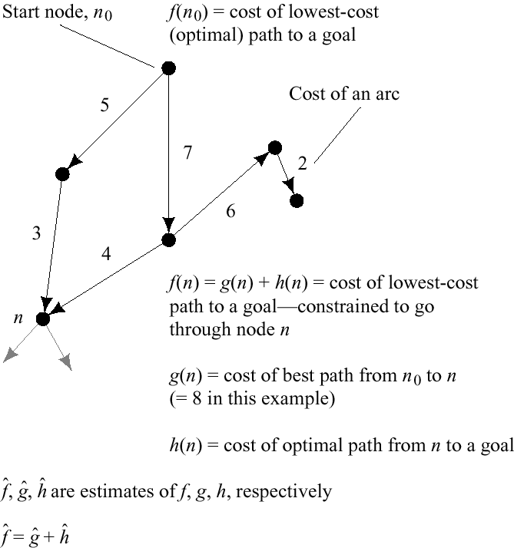

Slide 17
Example of A* search

Slide 18
Behavior of A* - Termination
The heuristic function h(n) is called admissible if h(n) is never larger than h*(n), namely h(n) is always less or equal to true cheapest cost from n to the goal.
A* is admissible if it uses an admissible heuristic, and h(goal) = 0.
Theorem (completeness) (Hart, Nillson and Raphael, 1968)
  A* always terminates with a solution path if
    costs on arcs are positive, above epsilon
    branching degree is finite.
Proof: The evaluation function f of nodes expanded must increase eventually until all the nodes on an optimal path are expanded .

Slide 19
Behavior of A* - Completeness
Theorem (completeness for optimal solution) (HNL, 1968):
  If the heuristic function is admissible than A* finds an optimal solution.
Proof:
  1. A* will expand only nodes whose f-values are less (or equal) to the optimal cost path C* (f(n) less-or-equal c*).
  2. The evaluation function of a goal node along an optimal path equals C*.
Lemma:
  Anytime before A* terminates there exists and OPEN node n’ on an optimal path with f(n’) <= C*.

Slide 20
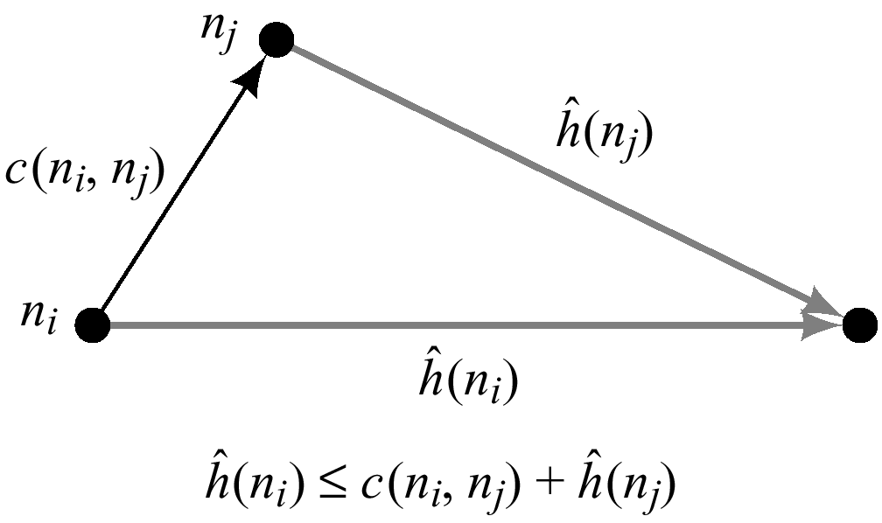
Consistent (Monotone) heuristics
If in the search graph the heuristic function satisfies triangle inequality for every n and its child node n’: h^(ni) less or equal h^(nj) + c(ni,nj)
when h is monotone, the f values of nodes expanded by A* are never decreasing.
When A* selected n for expansion it already found the shortest path to it.
When h is monotone every node is expanded once (if check for duplicates).
Normally the heuristics we encounter are monotone
  the number of misplaced ties
  Manhattan distance
  air-line distance

Slide 21
A* progress in contours, example

Slide 22
Dominance and pruning power of heuristics
Definition:
  A heuristic function h dominates h’ (more informed than h) if both are admissible and for every node n, h(n) is greater than h’(n).
Theorem (Hart, Nillson and Raphale, 1968):
  An A* search with a dominating heuristic function h has the property that any node it expands is also expanded by A* with h’.
Question: Is manhattan distance more informed than the number of misplaced tiles?
Extreme cases
  h = 0
  h = h*

Slide 23
Complexity of A*
A* is optimally efficient (Dechter and Pearl 1985):
  It can be shown that all algorithms that do not expand a node which A* did expand (inside the contours) may miss an optimal solution
A* worst-case time complexity:
  is exponential unless the heuristic function is very accurate
If h is exact (h = h*)
  search focus only on optimal paths
Main problem: space complexity is exponential
Effective branching factor:
  logarithm of base (d+1) of average number of nodes expanded.

Slide 24
Additional properties
A* expands every path along which f^(n) < C*
A* will never expand any node s.t f^(n) > C*
If h is monotone A* will expand any node such that f^(n) <C*
Therefore A* expands all the nodes for which f^(n) < C* and a subset of the nodes for which f^(n) = C*.
Therefore if h1(n) < h2(n) clearly the subset of nodes expanded is smaller.

Slide 25
Effectiveness of A* Search Algorithm
Average number of nodes expanded
d IDS A*(h1) A*(h2)
2 10 6 6
4 112 13 12
8 6384 39 25
12 364404 227 73
14 3473941 539 113
20 ------------ 7276 676
Average over 100 randomly generated 8-puzzle problems
h1 = number of tiles in the wrong position
h2 = sum of Manhattan distances

Slide 26
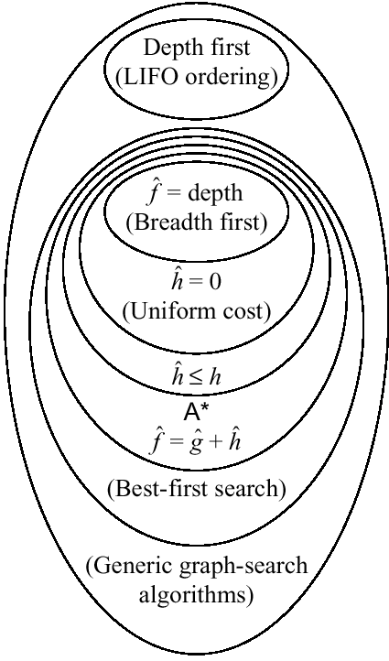
Relationships among search algorithms

Slide 27
Pseudocode for Branch and Bound Search
(An informed depth-first search)
Initialize: Let Q = {S}
While Q is not empty
pull Q1, the first element in Q
if Q1 is a goal compute the cost of the solution and update
L <-- minimum between new cost and old cost
else
child_nodes = expand(Q1),
<eliminate child_nodes which represent simple loops>,
For each child node n do:
evaluate f(n). If f(n) is greater than L discard n.
end-for
Put remaining child_nodes on top of queue in the order of their evaluation function, f.
end
Continue

Slide 28
1
4
A
B
C
2
S
2
5
G
5
3
2
4
D
E
F
A
10.4
B
C
6.7
4.0
11.0
G
S
8.9
3.0
6.9
D
E
F

Slide 29
Example of Branch and Bound in action
S
2
5
A
D

Slide 30
Properties of Branch-and-Bound
Not guaranteed to terminate unless has depth-bound
Optimal:
  finds an optimal solution
Time complexity: exponential
Space complexity: linear

Slide 31
Iterative Deepening A* (IDA*)
(combining Branch-and-Bound and A*)
Initialize: f <-- the evaluation function of the start node
until goal node is found
  Loop:
    Do Branch-and-bound with upper-bound L equal current evaluation function
    Increment evaluation function to next contour level
  end
continue
Properties:
  Guarantee to find an optimal solution
  time: exponential, like A*
  space: linear, like B&B.

Slide 32
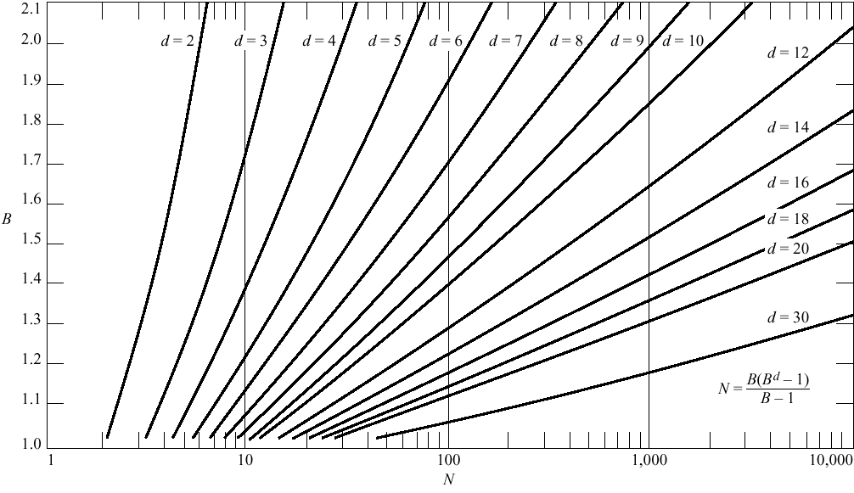

Slide 33
Inventing Heuristics automatically
Examples of Heuristic Functions for A*
  the 8-puzzle problem
    the number of tiles in the wrong position
      is this admissible?
    the sum of distances of the tiles from their goal positions, where distance is counted as the sum of vertical and horizontal tile displacements (“Manhattan distance”)
      is this admissible?
  How can we invent admissible heuristics in general?
    look at “relaxed” problem where constraints are removed
      e.g.., we can move in straight lines between cities
      e.g.., we can move tiles independently of each other

Slide 34
Inventing Heuristics Automatically (continued)
How did we
  find h1 and h2 for the 8-puzzle?
  verify admissibility?
  prove that air-distance is admissible? MST admissible?
Hypothetical answer:
  Heuristic are generated from relaxed problems
  Hypothesis: relaxed problems are easier to solve
In relaxed models the search space has more operators, or more directed arcs
Example: 8 puzzle:
  A tile can be moved from A to B if A is adjacent to B and B is clear
  We can generate relaxed problems by removing one or more of the conditions
    A tile can be moved from A to B if A is adjacent to B
    ...if B is blank
    A tile can be moved from A to B.

Slide 35
Generating heuristics (continued)
Example: TSP
Finr a tour. A tour is:
  1. A graph
  2. Connected
  3. Each node has degree 2.
Eliminating 2 yields MST.

Slide 36
Automating Heuristic generation
Use Strips representation:
Operators:
  Pre-conditions, add-list, delete list
8-puzzle example:
  On(x,y), clear(y) adj(y,z) ,tiles x1,…,x8
States: conjunction of predicates:
  On(x1,c1),on(x2,c2)….on(x8,c8),clear(c9)
Move(x,c1,c2) (move tile x from location c1 to location c2)
  Pre-cond: on(x1.c1), clear(c2), adj(c1,c2)
  Add-list: on(x1,c2), clear(c1)
  Delete-list: on(x1,c1), clear(c2)
Relaxation:
1. Remove from prec-dond: clear(c2), adj(c2,c3) → #misplaced tiles
2. Remove clear(c2) → manhatten distance
3. Remove adj(c2,c3) → h3, a new procedure that transfer to the empty location a tile appearing there in the goal

Slide 37
Heuristic generation
The space of relaxations can be enriched by predicate refinements
Adj(y,z) iff neigbour(y,z) and same-line(y,z)
The main question: how to recognize a relaxed problem which is easy.
A proposal:
  A problem is easy if it can be solved optimally by agreedy algorithm
Heuristics that are generated from relaxed models are monotone.
Proof: h is true shortest path I relaxed model
  H(n) <=c’(n,n’)+h(n’)
  C’(n,n’) <=c(n,n’)
  → h(n) <= c(n,n’)+h(n’)
Problem: not every relaxed problem is easy, often, a simpler problem which is more constrained will provide a good upper-bound.

Slide 38
Improving Heuristics
If we have several heuristics which are non dominating we can select the max value.
Reinforcement learning.

Slide 39
Planning, Acting and Learning
(Nillson Ch 10)
Sense/Plan/Act cycle:
  Uncertainty in sensors of the environment
  Effect of action uncertain
  Dynamic world is changing in an unpredictable manner
  Agent may need to plan quickly before plan is complete
  Computational resources for computing a complete plan are insufficient.
Approaches
  Markov decision processes (MDPs) \
  Partially observable Markov Decision Processes (POMDPs)
  Sense/Plan/Act architecture: execute first action and replan
Algorithms:
  Aaproximate search
    Island driven search and hierarchical search
    Limited Horizon search
    Learning Heuristic functions (during simulation or execution)
    Reinforcement learning

Slide 40
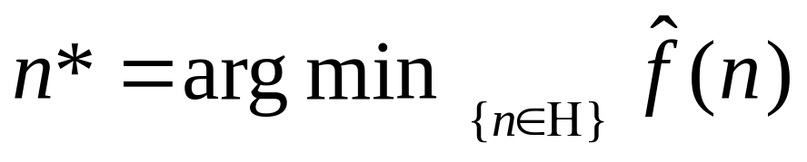
Limited Horizon Search
When search to completion is too costly. Given a time limit select an action.
Search to a predefined horizon of depth d.
We want to find an optimal path to a node at depth d whose evaluation function is smallest.
Take first action to n*, sense the resulting state and iterate by searching again.
Use Branch and Bound with the evaluation function f(n) (the bound is called alpha-cutoff, analogous to alpha-beta in games).
Special case , d=1, leads to greedy search:

Slide 41
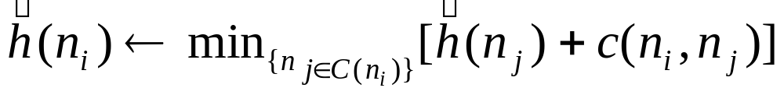
Learning Heuristic Functions
Learning Real time A* (LRTA*)
If there is no good heuristic and the explicit graph can remembered.
  When a good model is available, learning can be done during simulation
  Otherwise, learning can be done during actual execution
Learning with a good model
  Initialize h^=0 for every node
  After expanding a child node or ni update:
  h^ can be stored in a table.
  h(goal)=0
A* will be not better than uniform cost after first time to a goal

Slide 42
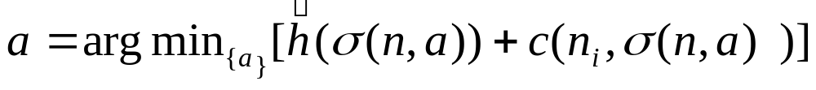
Learning Heuristic functions
Reinforcement learning (Sutton 1990)
When the agent does not have a model he can use the same update rule during execution, does random walk initially until a goal is reached.
The effect of actions are learnt during execution. Learn explicit graph.
A visited state is recorded and its h is updated:
Initially h^(n) = 0.
Action: choose next action a s.t.
Keep truck of all nodes
Problems: Learning suboptimal path
Remedied: allow occasional random actions.

Slide 43
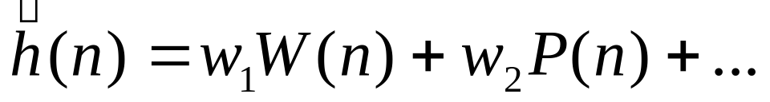
Learning an implicit heuristic during execution
When storing all nodes is NOT practical
Guess a set of relevant features f a state
  (P(n): Manhattan distance, W(n), number of misplaced tiles.)
Assume a linear weighted function.
Start with arbitrary weights. When stumble on a goal update the weights minimizing sum square errors when all the instances on the paths are examples. The process is performed iteratively over several searches.
Temporal difference(Sutton 1988): after expanding node ni to produce successor nodes nj we adjust the weight so that:

Slide 44

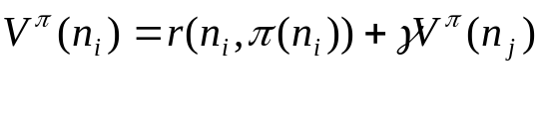
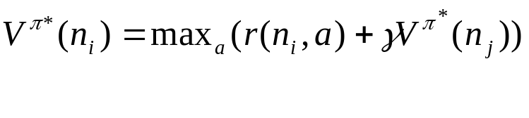
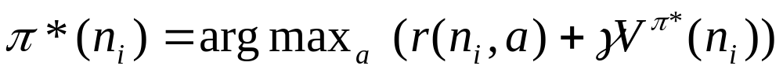
Rewards instead of goals
Each action in a state is associated with a reward r(ni,a)
We seek an action policy that maximizes discounted reward of agent.
Let be a policy function from state to actions
We want to find a policy s.t.
Value iteration algorithm:

Slide 45
Summary
In practice we often want the goal with the minimum cost path
Exhaustive search is impractical except on small problems
Heuristic estimates of the path cost from a node to the goal can be efficient in reducing the search space.
The A* algorithm combines all of these ideas with admissible heuristics (which underestimate) , guaranteeing optimality.
Properties of heuristics:
  admissibility, monotonicity, dominance, accuracy
Branch and Bound:
  an informed depth-first search
Reading
  Nillson Chapter 9, 10, R&N Chapter 4.

